Slide 1



The 20th IEEE International Conference on Mobile Ad-Hoc and Smart Systems (MASS 2023)
Cooperative and Autonomous Mapping for Heterogeneous NAVs
Ruiwen Xu, Yongtao Ou, Hanjie Yu, Ziyi Zhang,
Feng Shan, Weiwei Wu, Junzhou Luo
Southeast University, Nanjing, China
Notes:
Good morning, chairs, experts and scholars! I feel very honored to present our group‘s research results on self-organized mapping for Nano unmanned aerial vehicles here.

Slide 2
01 INTRODUCTION
02 TINYOCTOMAP
03 AUTONOMOUS EXPLORATION ALGORITHM
04 EDGE-ASSISTED OFFLOADING
05 IMPLEMENTATION
06 CONCLUSION

Slide 3
01
PART ONE
Introduction

Slide 4
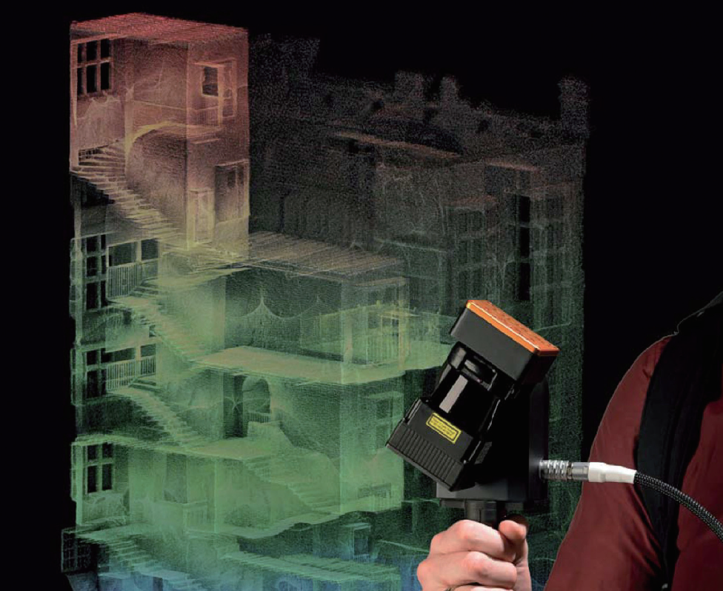
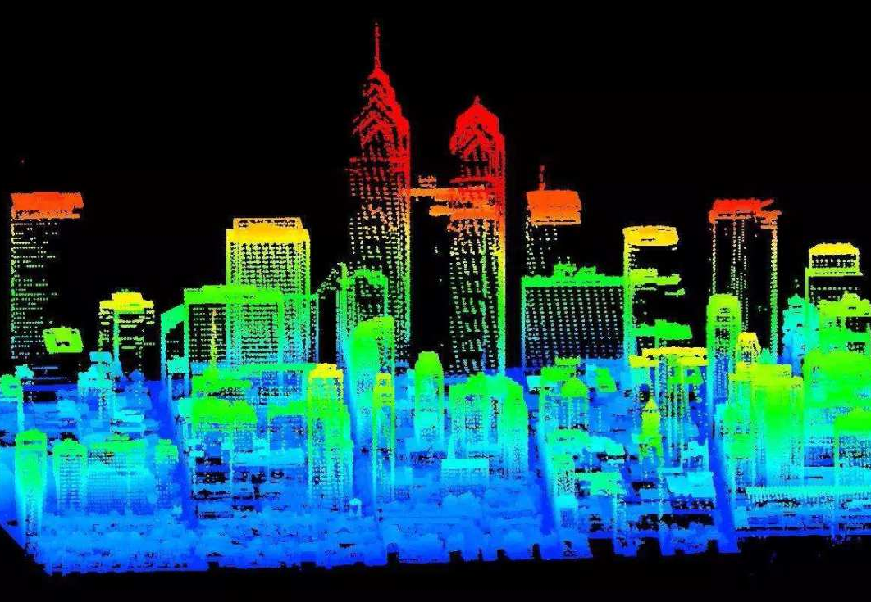
Classic Mapping
Expensive equipment and human intervention
Large scenes and extensive point cloud
Notes:
Traditional 3D modeling methods often require expensive equipment and human intervention, which limits their application in narrow and confined spaces. However, autonomous/ ɔːˈtɒnəməs / exploration flights using heterogeneous / ˌhetərəˈdʒiːniəs / (NAVs) offer promising solutions for 3D modeling in such challenging environments.

Slide 5
Autonomous Mapping for NAV
Introduction
Easy Deployment
High Agility
High Mobility
Autonomous Mapping for Nano-UAVs(NAVs) refers to the process of mapping without external control signal input, the NAV utilizes only the data from its own sensors to to navigate and complete the mission.
advantages
Notes:
Autonomous mapping with NAVs offers three main advantages: easy deployment, high agility / əˈdʒɪləti /, and high mobility / məʊˈbɪləti /.

Slide 6
Advantages and Disadvantages of NAV
Advantages
Disadvantages
Small size
inexpensive
adaptability to confined and complex environments
Low risk of accidents
Limited sensor performance
Low computing and storage capacity
Limited battery life
Notes:
The small size and low cost of NAV provide several advantages that make it suitable for navigation in confined / kənˈfaɪnd / and complex / ˈkɒmpleks / environments with low risk of accidents. However, NAVs also face several limitations, mainly related to limited sensor performance, low computing and storage capacity / kəˈpæsəti / and limited battery/ˈbætəri/ life.

Slide 7
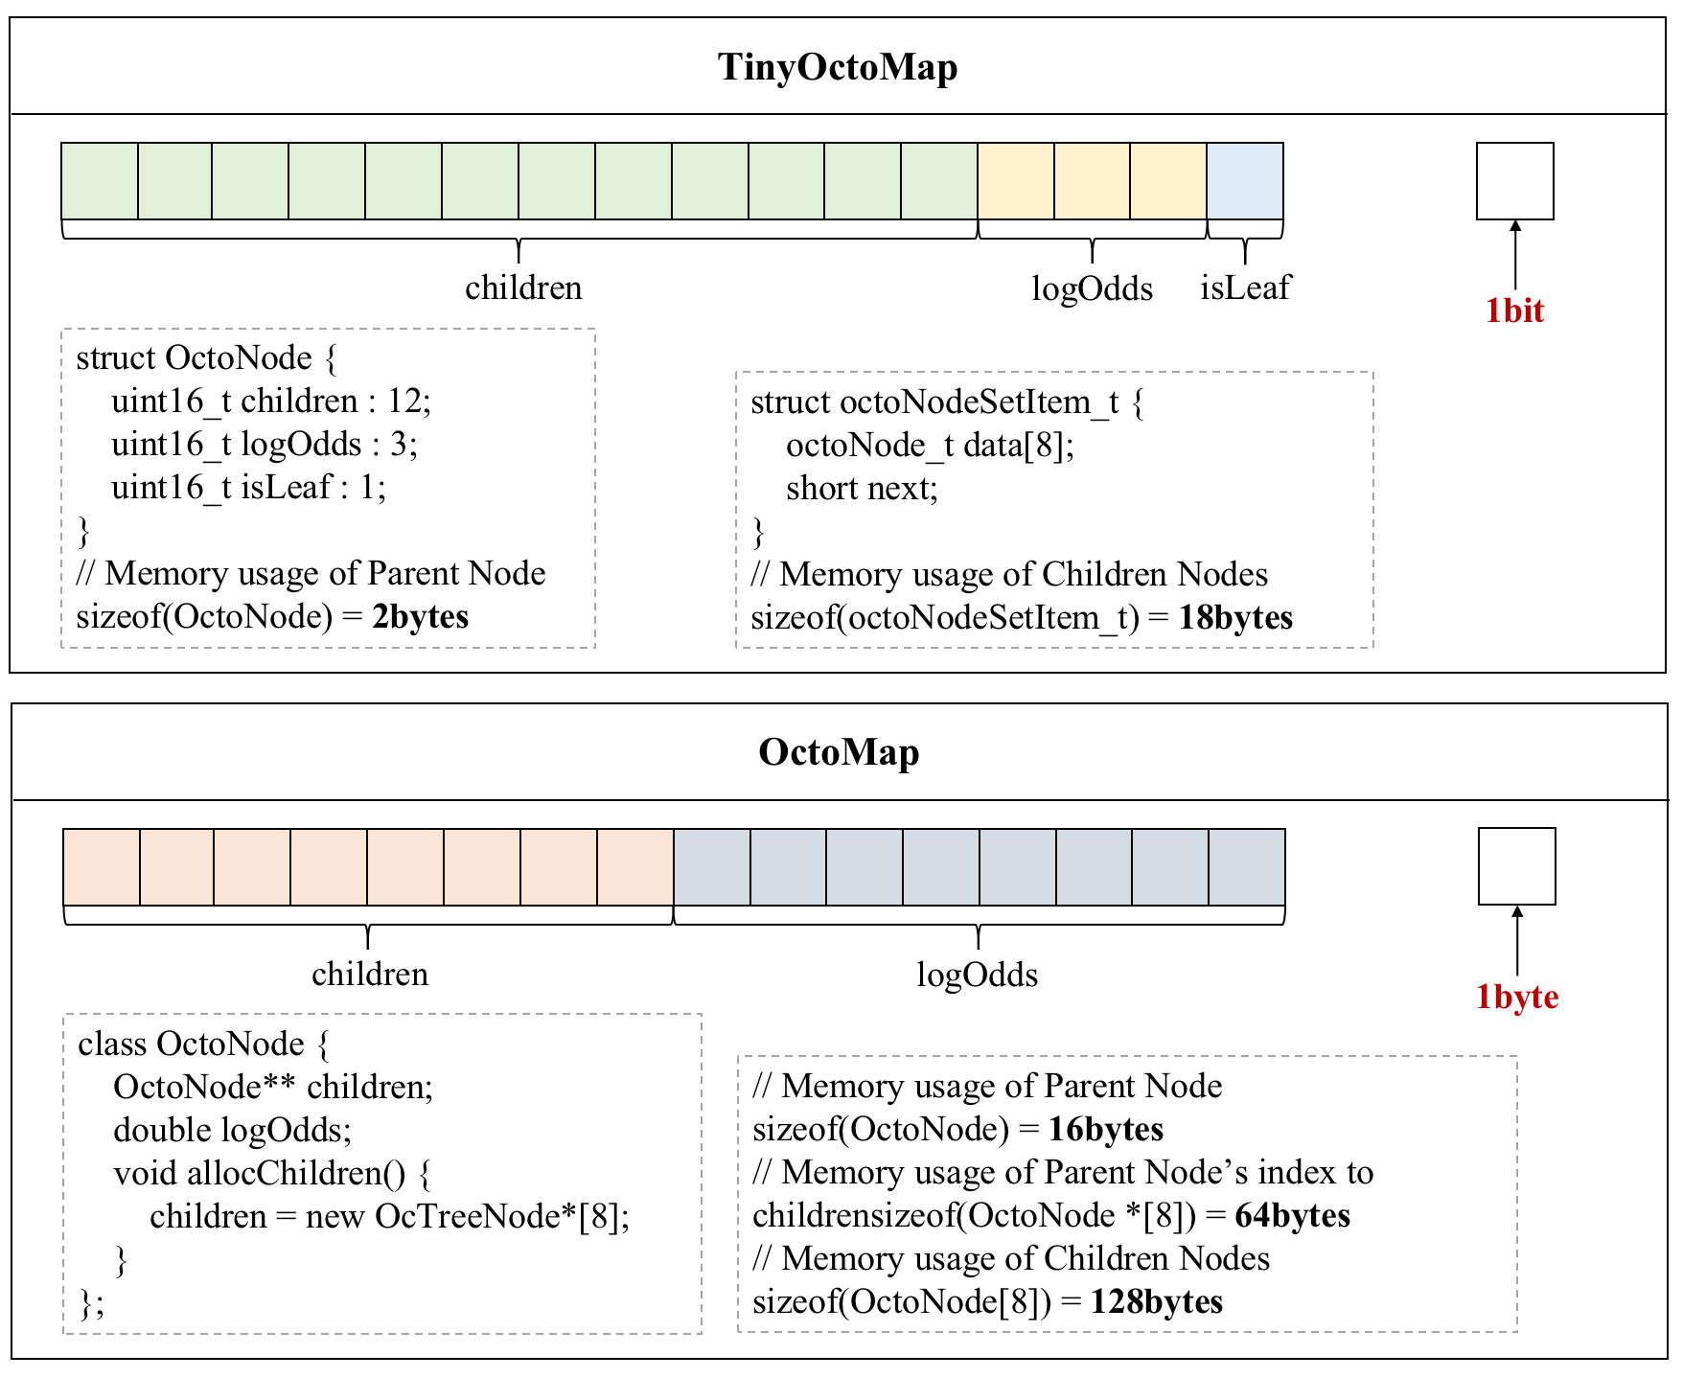
Challenge of mapping for NAV
Challenge 1 : Lack of appropriate map model
It is too memory intensive for NAV.
Notes:
So, the challenges faced in NAV mapping are as follows : 1. Lack of appropriate map model. Classical map models such as Octomap aim to optimize the memory space, which still consumes a large amount of memory, and is insufficient / ˌɪnsəˈfɪʃ(ə)nt / to support map storage.

Slide 8
Challenge of mapping for NAV
Challenge 2 : Lack of suitable navigation strategies
Current Strategic Concerns
1、Information Profit 2、Exploration Efficiency 3、…
Doesn‘t take into account memory pressure and map model features such as octree pruning operations.
Notes:
2.Lack of suitable navigation strategies. The current active exploration strategy pays more attention to the information profit and exploration efficiency, without considering the memory pressure and map model features, such as the pruning / ˈpruːnɪŋ / operation of the octomap.

Slide 9
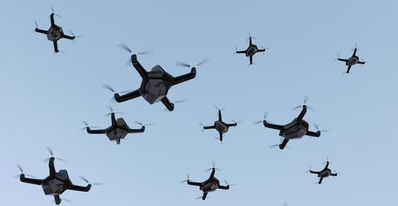
Challenge of mapping for NAV
Challenge 3 : Lack of a cooperative framework for heterogeneous NAVs
Multi-NAVs collaboration
Notes:
3. Lack of a cooperative framework for heterogeneous NAVs. The performance of a single NAV is always limited. Therefore, effective cooperation between NAV is required to build 3D maps of larger areas / ˈeəriəz /. To achieve this goal, a heterogeneous NAV cooperation framework is crucial.
In our study, we address these challenges by proposing a new framework for mapping using autonomous NAV exploration in narrow and confined environments.

Slide 10
02
PART TWO
TINYOCTOMAP
Notes:
First, let’s briefly introduce our optimization of the traditional octoMap model, which named TinyOctoMap.

Slide 11
TinyOctoMap
TinyOctoMap is proposed in order to achieve efficient resource utilization in indoor NAVs navigation scenarios.
The design of the tree nodes is optimized as follows：
Subnode index children
Node occupation level logOdds
Use a bitfield to store members
In comparison to the conventional OctoMap map model, the proposed model exhibits a significant reduction of 85.94% in memory usage while maintaining the same number of voxel blocks.
Notes:
We optimize the traditional octoMap model by retaining its feature of being prunable and optimizing its memory footprint at a single node, which reduces the memory usage of a single tree node by 85.94%. There are three main optimizations as follows:
1、Since the TinyOctomap model uses a memory pool to preallocate memory statically and the sibling / ˈsɪblɪŋ / nodes are stored in a contiguous memory space, the child nodes can save storage space by retaining only the index of the first child node. 2、Since the node occupancy status is updated in a stepwise hierarchy, unsigned integer / ˈɪntɪdʒə(r) /storage can be used to represent the node occupancy status more efficiently. 3、These members can be further compressed and stored in a 16-bit field.

Slide 12
03
PART THREE
AUTONOMOUS EXPLORATION ALGORITHM
Notes:
Next, let us describe our proposed autonomous exploration algorithm, which is mainly designed and proposed based on the Next Best View theory.

Slide 13
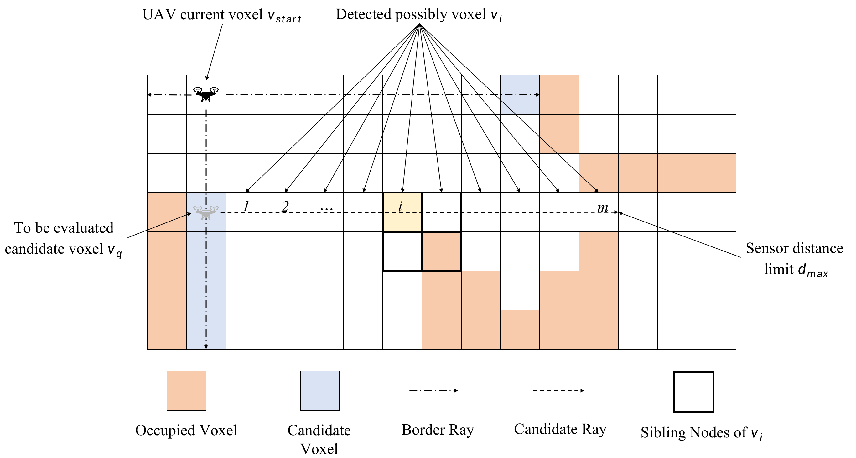
Design of Active Exploration
Based on Next Best View (NBV) theory
Selected a candidate set of next waypoints, Q, from the current location.
An evaluation function is established to evaluate the candidate waypoints based on the map coverage, navigation cost, state uncertainty, and other metrics.
The optimal waypoint for the next moment at the current position is selected based on the greedy strategy
Notes:
The NBV theory design of autonomous exploration strategy is usually divided into three steps: 1. Selected the candidate set according to the current coordinates. 2. Establish an evaluation function to score different candidate points. 3. Select the optimal candidate point

Slide 14
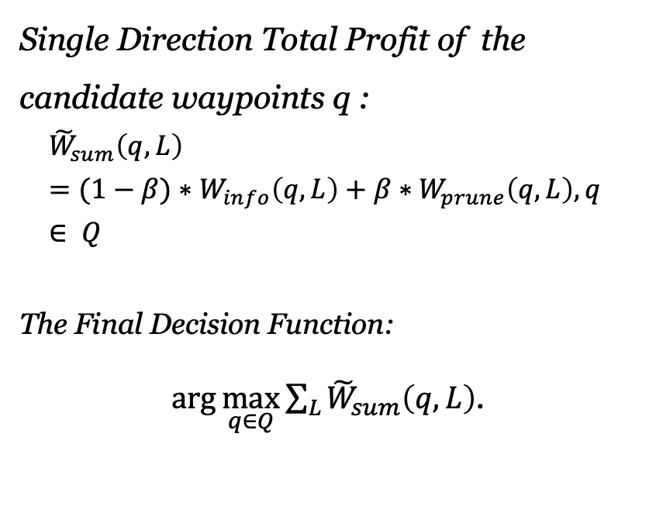
Design of Active Exploration
Single Direction Total Profit of the candidate waypoints q :
$${\tilde{W}}_{sum}\left(q,L\right)=(1−β)∗W_{info}\left(q,L\right)+β∗W_{prune}\left(q,L\right),q ∈ Q$$
The Final Decision Function:
$\arg{\max_{q∈Q}{\sum_{L}{{\tilde{W}}_{sum}\left(q,L\right)}}}$.
Notes:
This shows the evaluation function. We calculate the total profit by taking a weighted sum of information profit and pruning profit, where beta is equal to memory utilization.
The information profit depends on the new nodes discovered by LIDAR at the candidate point q.
The pruning profit depends on the number of times that the pruning is triggered by the updated information at the candidate point q. For the specific expression, please refer to our paper.

Slide 15
04
PART FOUR
EDGE-ASSISTED OFFLOADING
Notes:
Part 4 mainly introduce the EDGE-ASSISTED OFFLOADING.

Slide 16
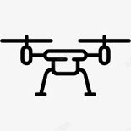
SYSTEM OVERVIEW
Edge-NAV:
Mapping Req; Exploration Req
Exploration Resp
Multi Lidar-NAVs:
…
Three kinds of packets for the cooperative autonomous mapping in the heterogeneous NAV:
Message Type | Data Content
Mapping Request | Variable-length structure array
Exploration Request | current coordinate, attitude, and range
Exploration Response | next coordinate
Notes:
The overall system consists of two kinds of NAVs, Edge-NAV and Lidar-NAV. The Lidar-NAV send the Mapping Request, which carries the NAV position and measurement, to the Edge NAV to offload the Mapping mission.
Relying on the Exploration Request and Response messages to complete the exploration mission.

Slide 17
SYSTEM OPTIMIZATION
1. Merge duplicate rays to accelerate building map
2. Adjust edge-NAV positions dynamically using the artificial potential field (APF) method
Notes:
In order to further optimize the communication quality, the following two optimizations are made in this paper: 1. Merge duplicate rays to accelerate building map, such as the figure 2. Adjust edge-NAV positions dynamically using the artificial potential field (APF) method to guarantee the communication quality of multiple Lidar and Edge NAVs.

Slide 18
05
PART FIVE
Implementation
Notes:
The fifth part mainly introduces the experimental part of this paper.

Slide 19
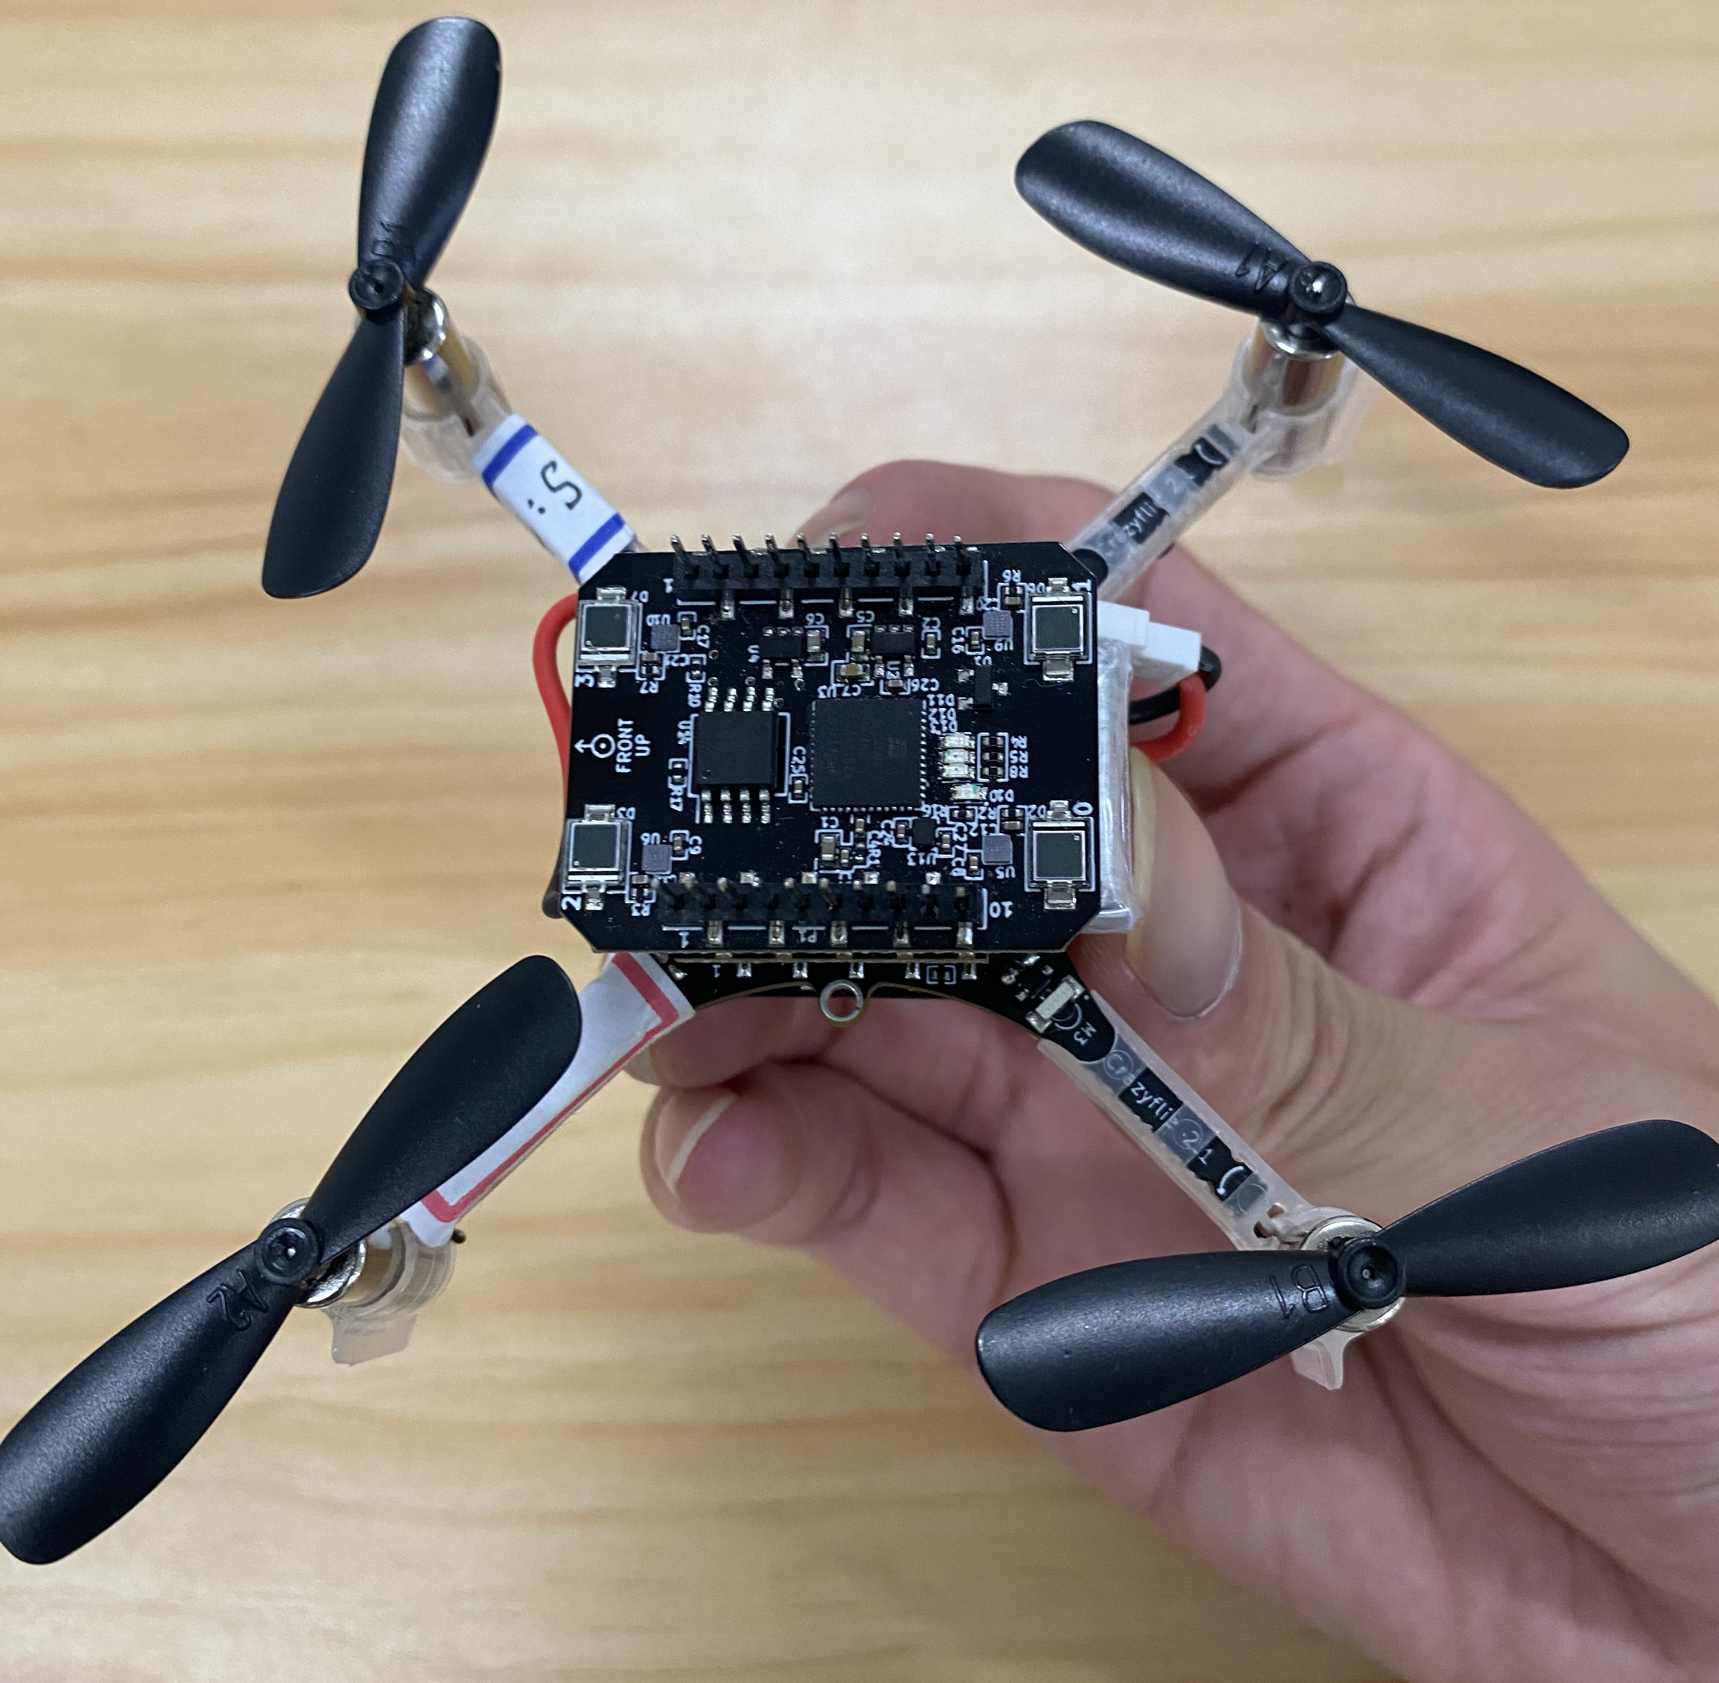
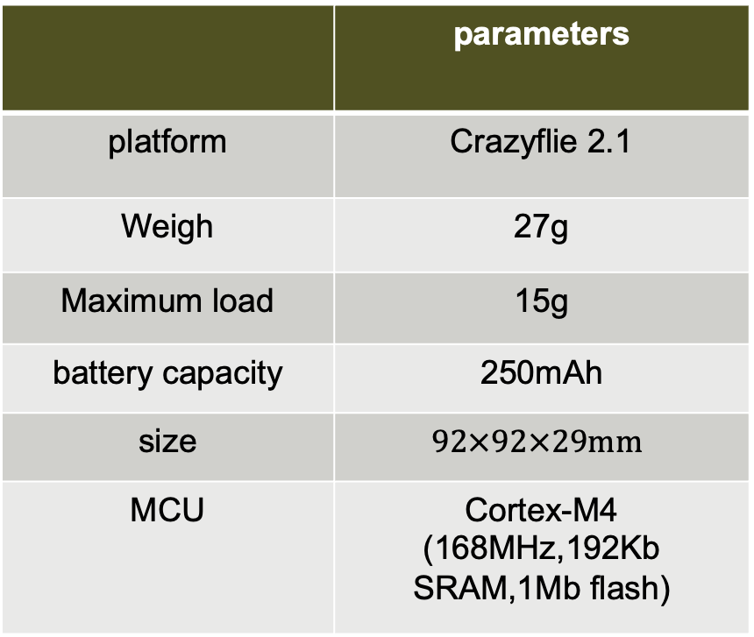
Parameters of NAV
 | parameters
platform | Crazyflie 2.1
Weigh | 27g
Maximum load | 15g
battery capacity | 250mAh
size | $$92×92×29mm$$
MCU | Cortex-M4 (168MHz,192Kb SRAM,1Mb flash)
Notes:
This is the parameter of the NAV used in the experiment of our paper, it can be noticed that its total memory is only 192kb(/ ˈkɪləbaɪt /).

Slide 20
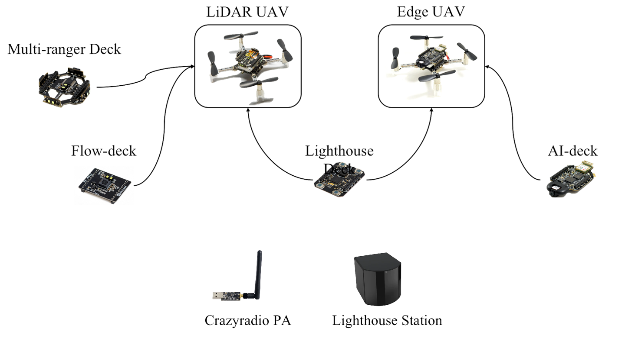
Experimental Deck
Deck
Multi-ranger Deck | measures the distance to objects in different directions.
Flow-Deck | gives the Crazyflie the ability to detect its motions in any direction.
Lighthouse Deck | uses the base stations to achieve high precision positioning.
AI-deck | Make Crazyflie edge computing capable.
Crazyradio PA | It is a long range open USB radio dongle.
Notes:
This is the introduction of the expansion board and its functions designed in the experiment of this paper: the Multi-ranger deck provides the Lidar ranging function, the Ai-deck provides the edge computation function.

Slide 21
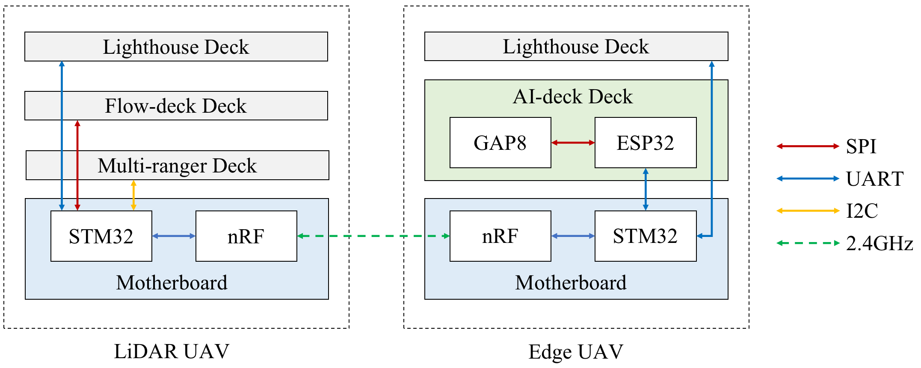
Communication Link
the inter-NAV and inter-board communication architecture:
Notes:
The inter-NAV communication is 2.4GHz(gigaHertz/ ˈɡɪɡəhɜːts /), and the communication between NAV main board and deck has SPI, URAT, I2C(I-squared / skweəd /-C) and other communication links.

Slide 22
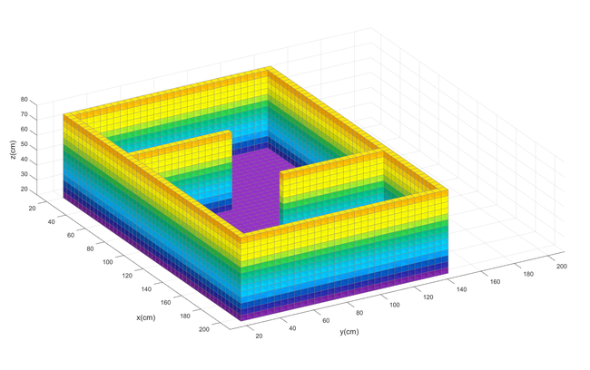
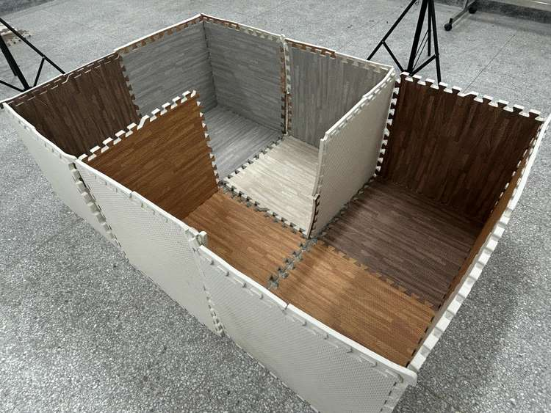
Experimental map
Real map
Simulation map
Notes:
This show the map of the experiments in this paper.

Slide 23
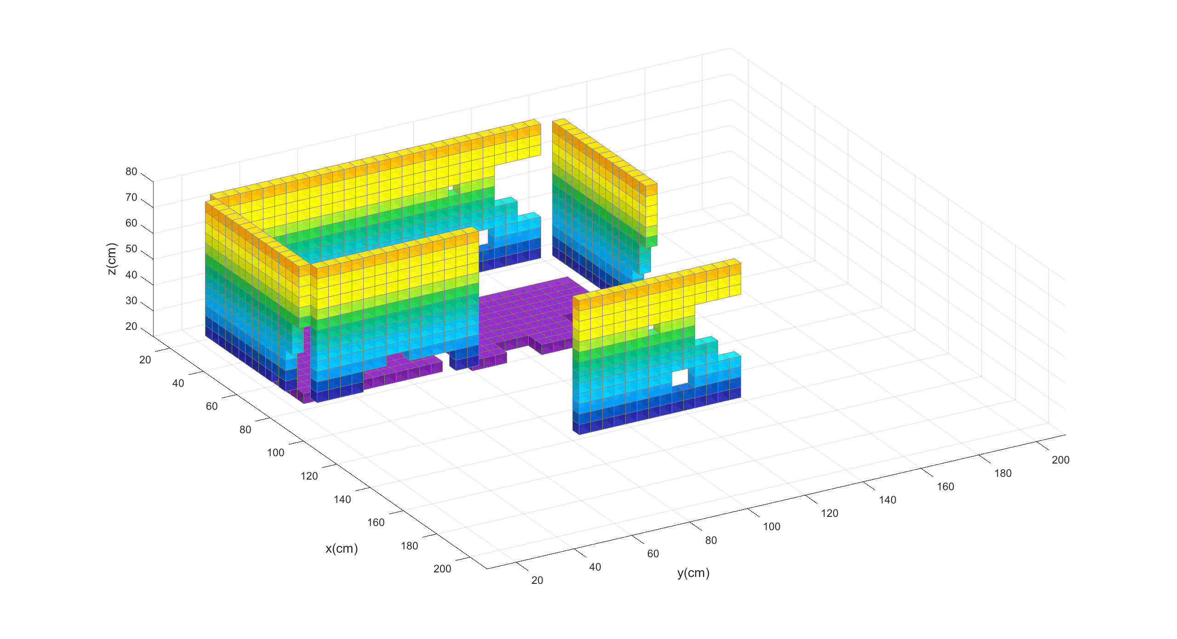
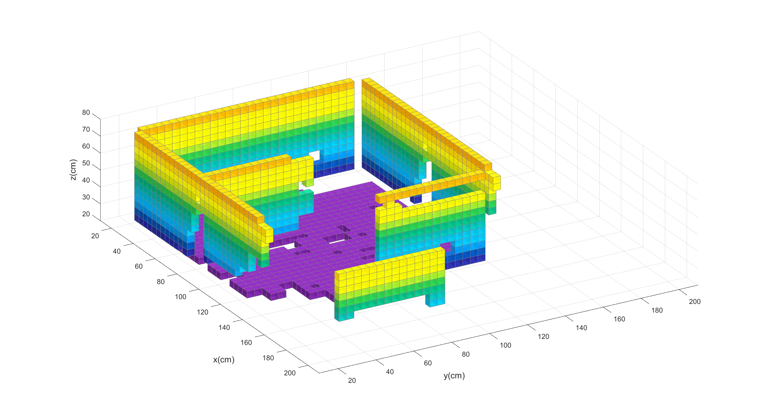
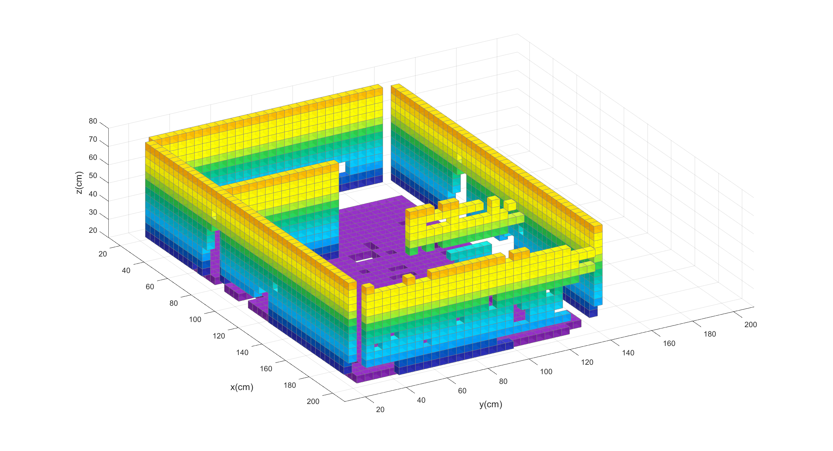
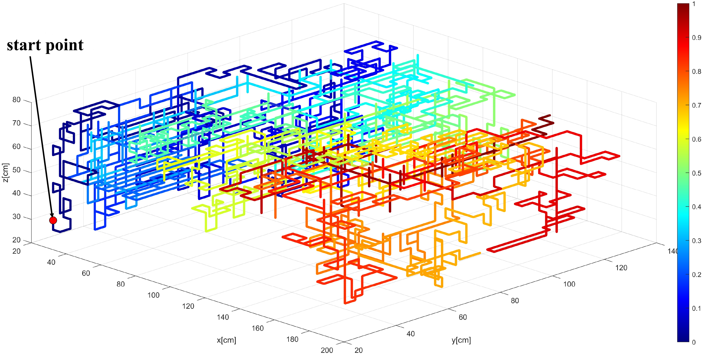
Singal-NAV Simulation Result(4cm accuracy)
The effect of NAV mapping at different moments and the final flight path.
(a)Time = 300s
(b)Time = 650s
(c)Time = 1000s
(d)Flight path
Notes:
Firstly, this shows the simulation results of the single NAV. Fig. (a) (b) (c) gives the map exploration completion at different moments. Figure (d) is the final flight path.

Slide 24
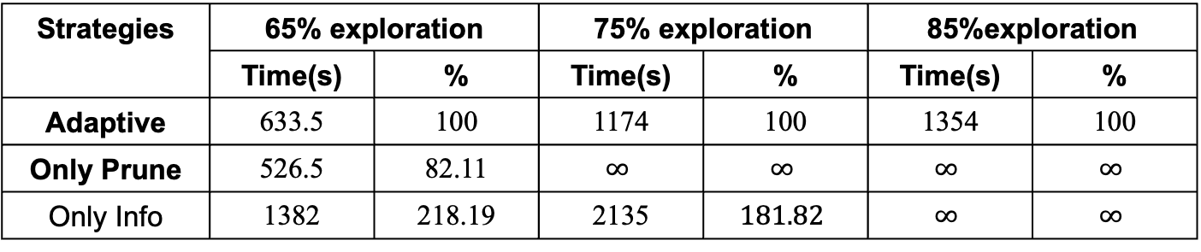
Comparison of different exploration strategies(2cm accuracy)
Results comparing traditional navigation strategies：
70.01
88.7
77.67
Strategies | 65% exploration |  | 75% exploration |  | 85%exploration
 | Time(s) | % | Time(s) | % | Time(s) | %
Adaptive | 633.5 | 100 | 1174 | 100 | 1354 | 100
Only Prune | 526.5 | 82.11 | $$∞$$ | $$∞$$ | $$∞$$ | $$∞$$
Only Info | 1382 | 218.19 | 2135 | $$181.82$$ | $$∞$$ | $$∞$$
Notes:
In order to analyze the performance of the exploration strategy proposed in this paper, a comprehensive comparison is made among different exploration strategy. The final results show that the exploration strategy proposed in our paper achieves the optimal exploration completion. What’s more, the exploration efficiency is not sacrificed / ˈsækrɪfaɪst /.

Slide 25
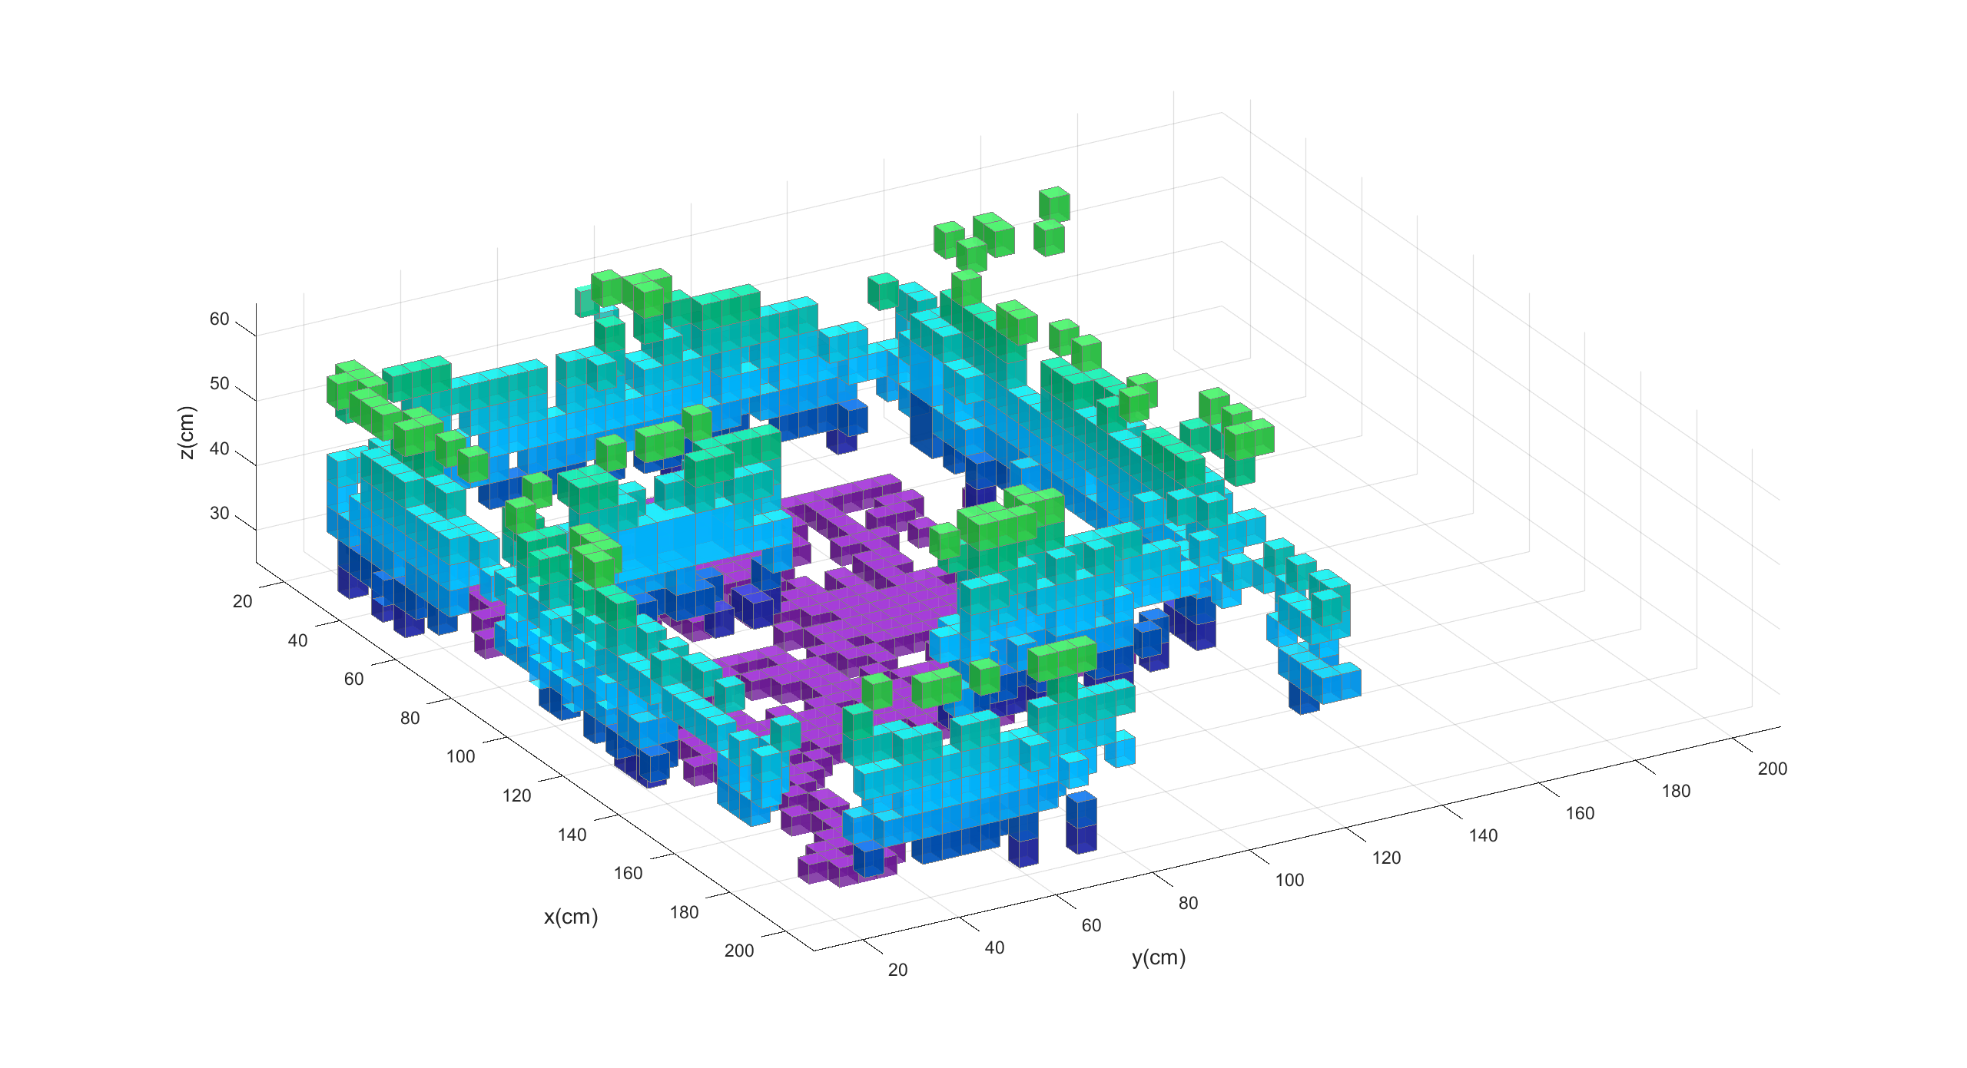
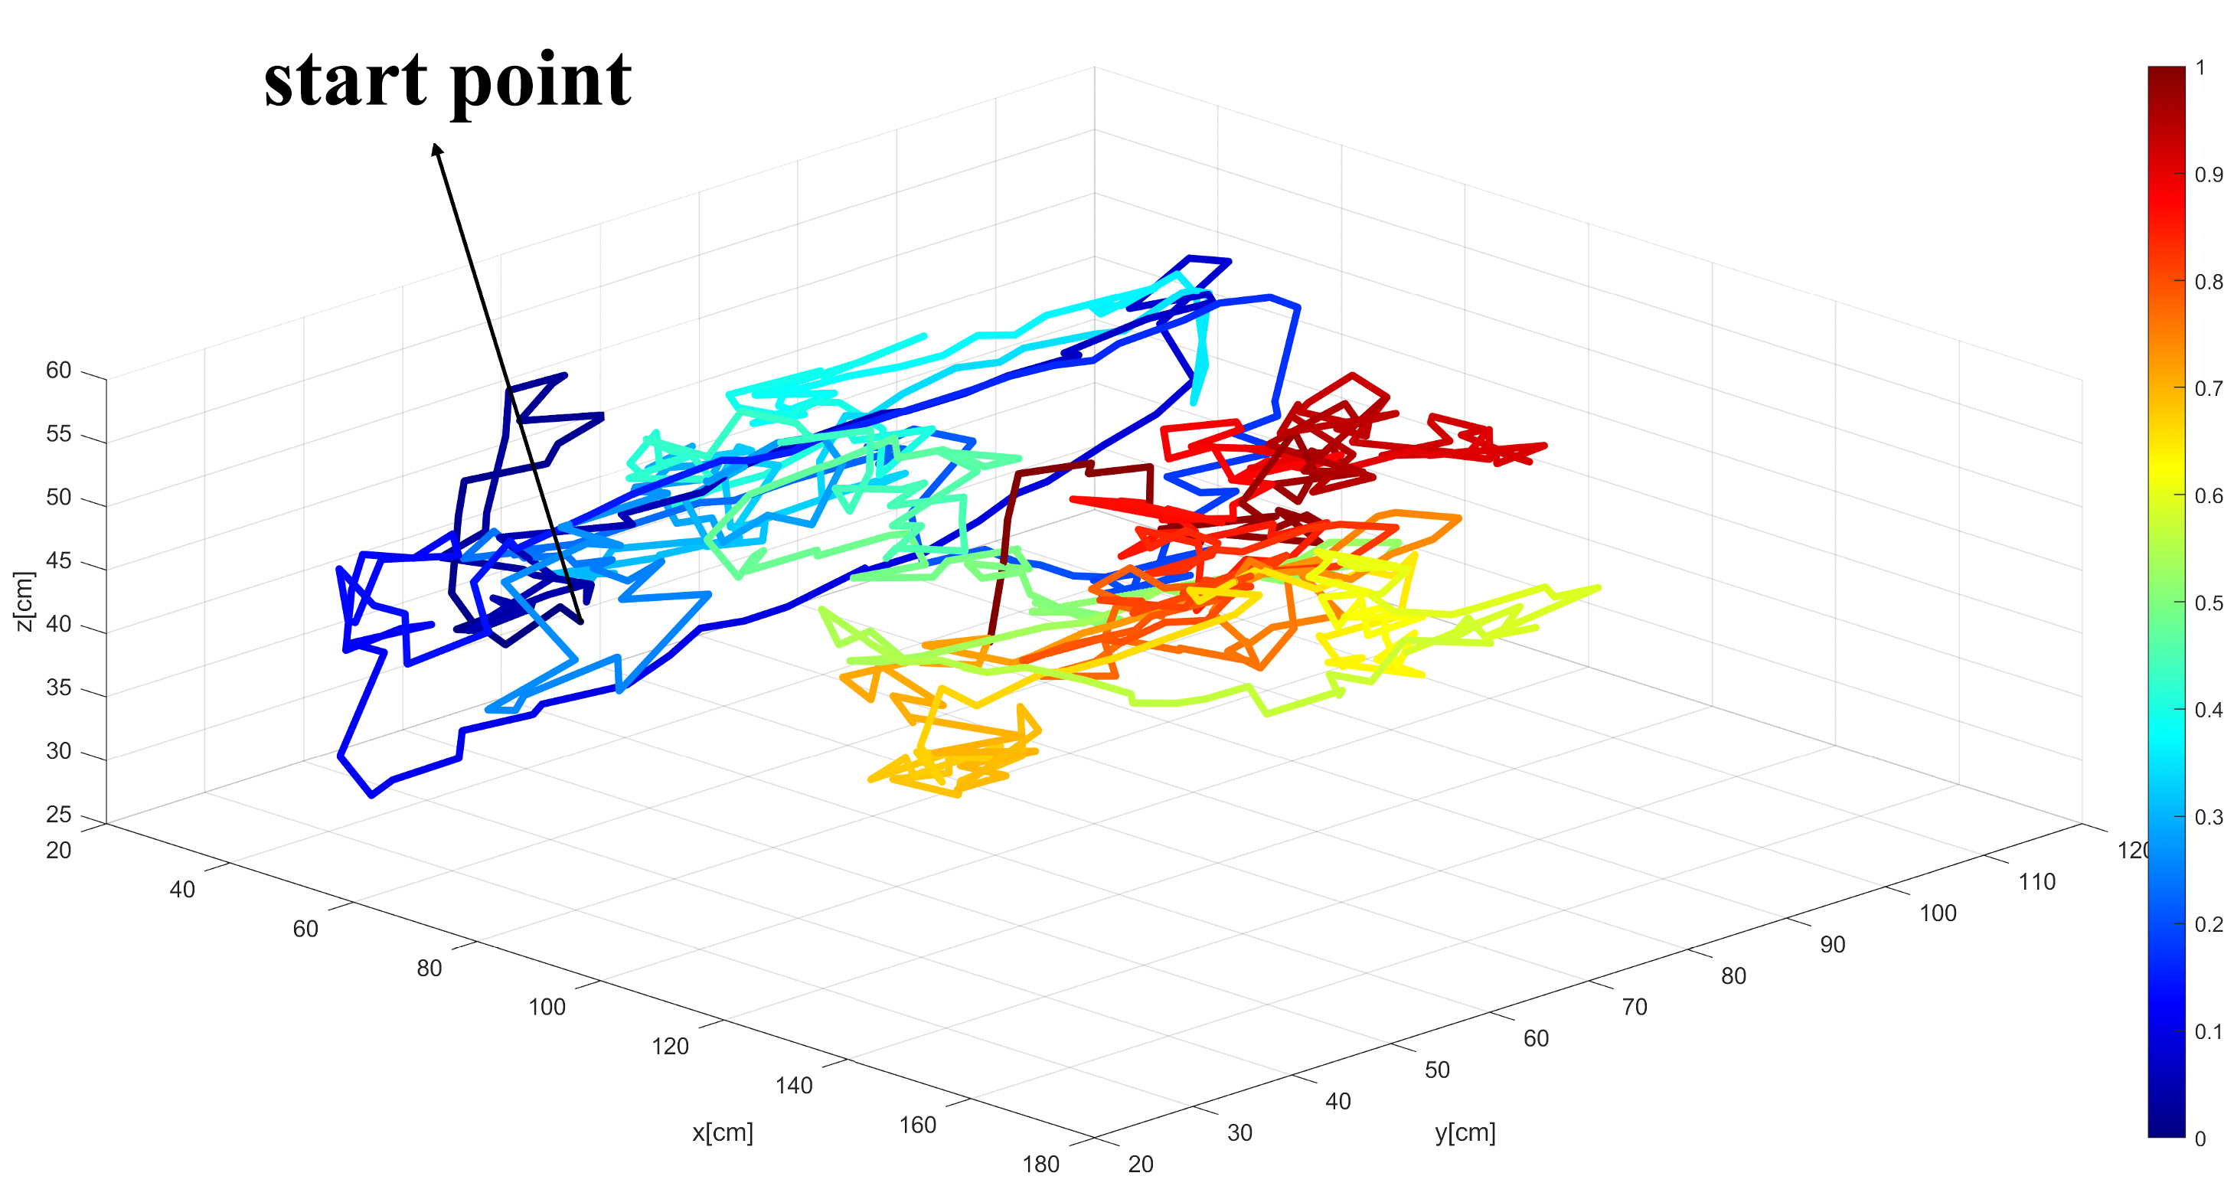
Single-NAV Real Result(4cm accuracy)
Real experimental results：
Time = 175s
Flight path
Due to NAV flight safety considerations, the NAV flight altitude needs to be at least 30 centimeters above the ground
Notes:
Next, the effectiveness of single-NAV autonomous exploration is further verified through real experiments. Noted that due to NAV flight safety considerations, the NAV flight altitude needs to be at least 30 centimeters above the ground.

Slide 26
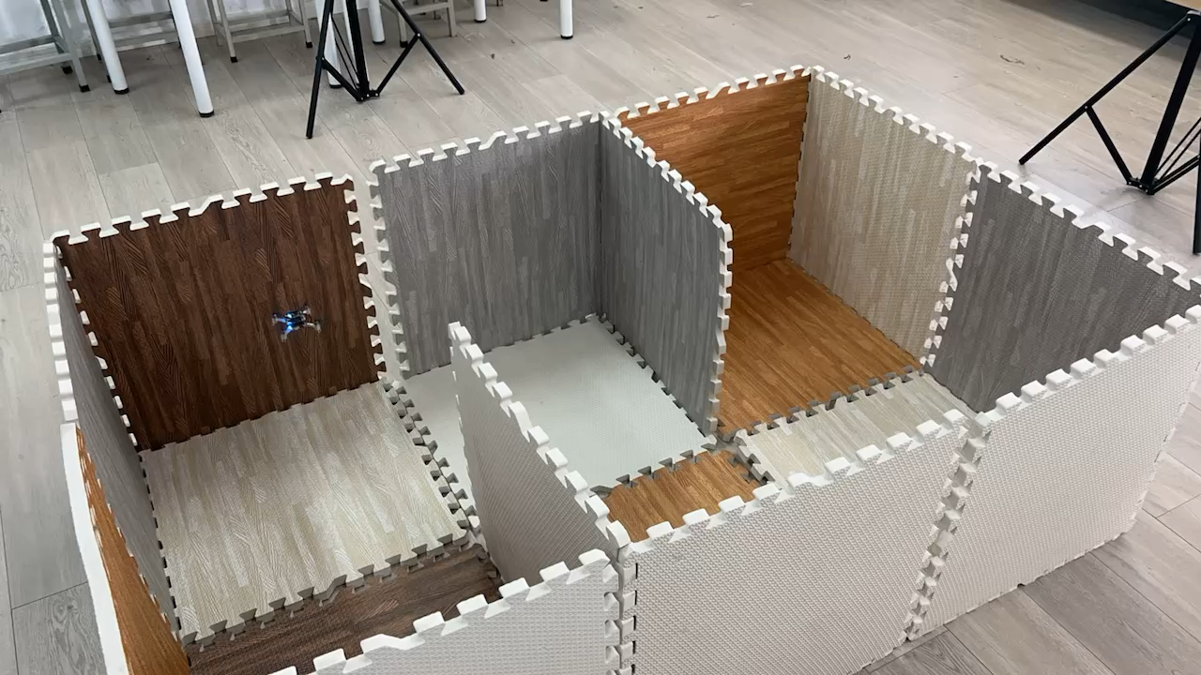

Slide 27
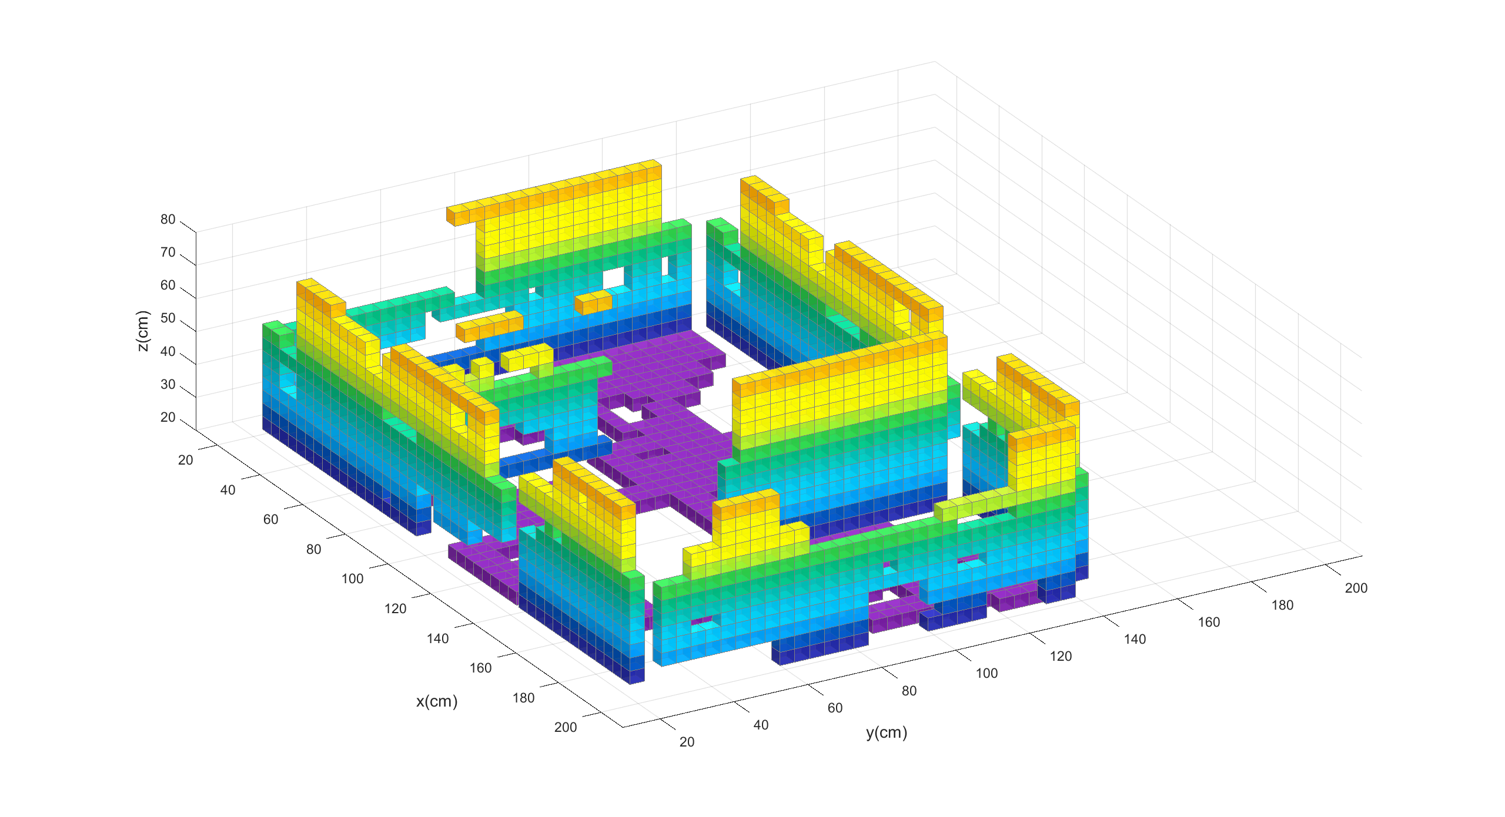
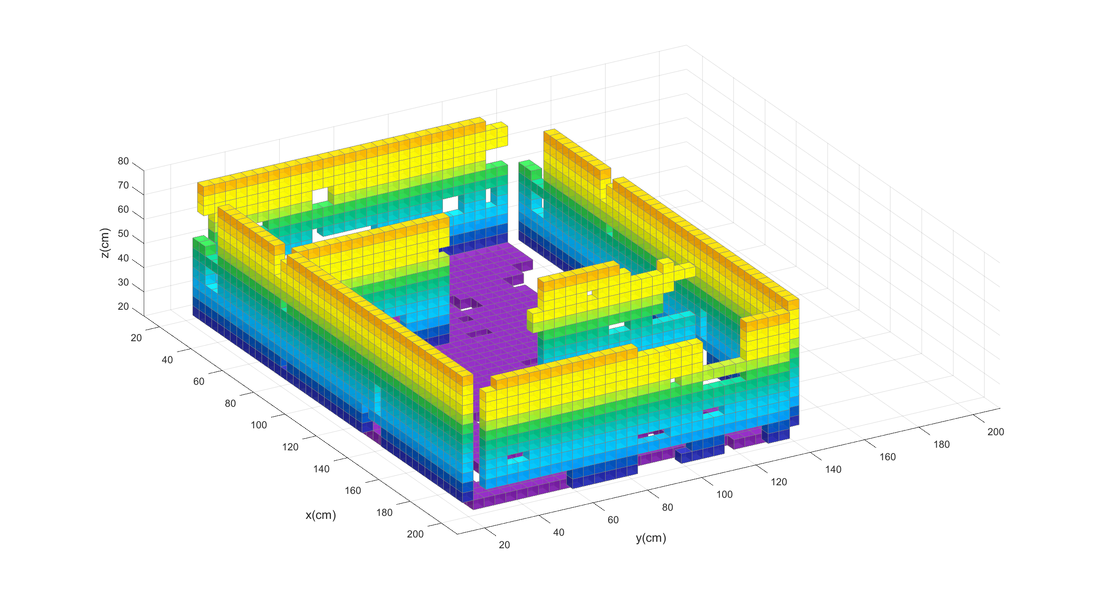
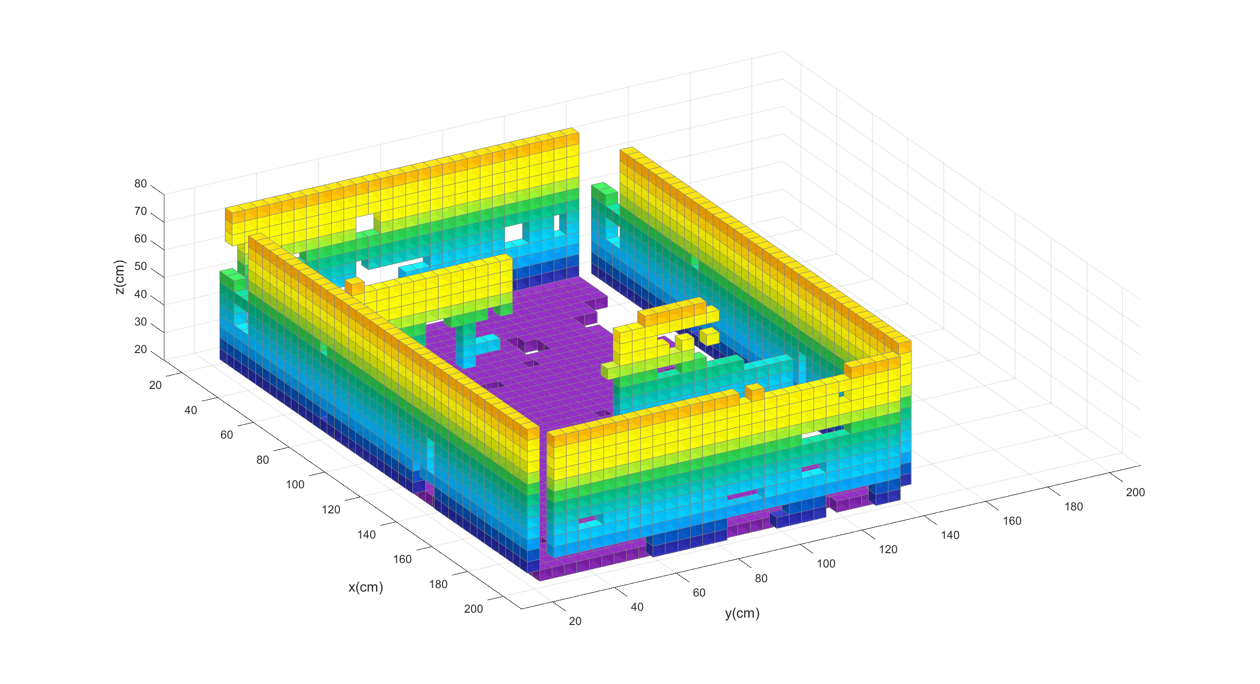
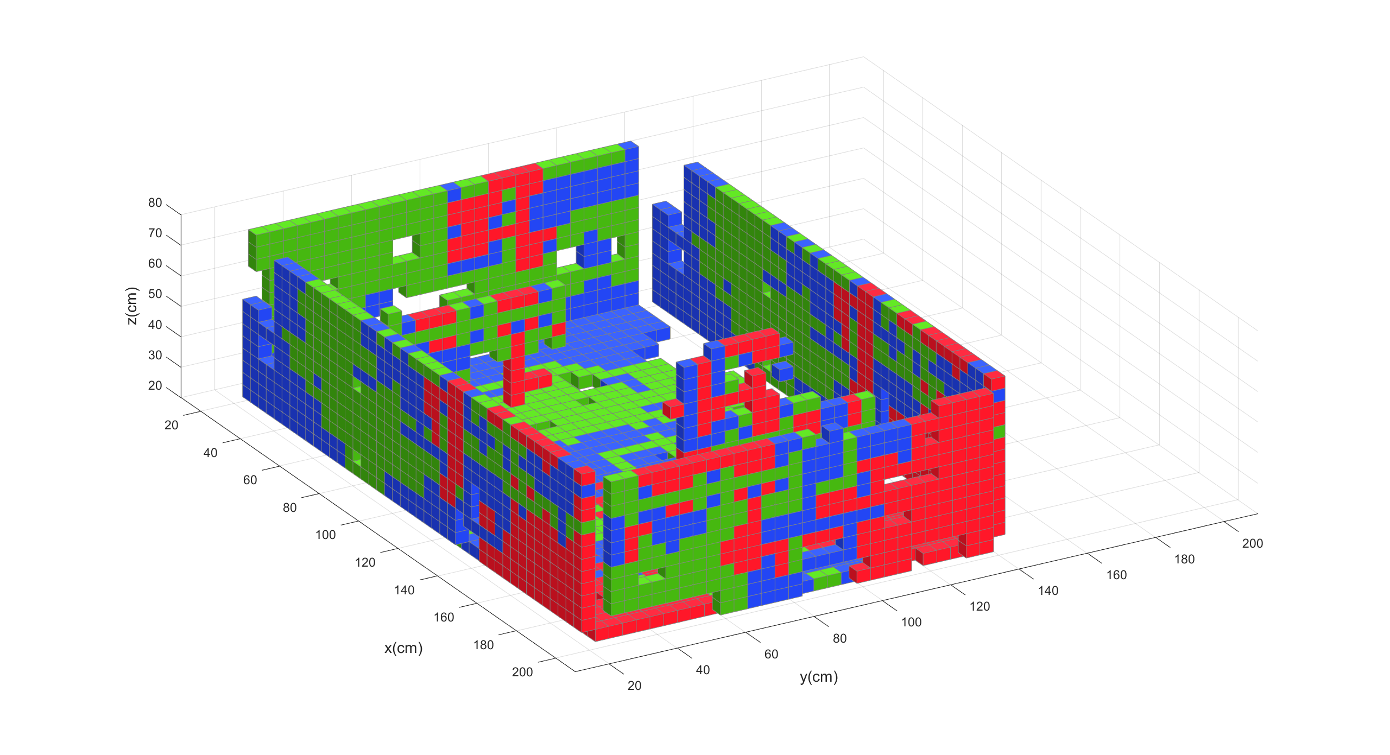
Triple-NAVs Simulation Result(4cm accuracy)
The effect of triple-NAVs mapping at different moments and the final Tricolor map.
(a)Time = 100s
(b)Time = 200s
(c)Time = 400s
(d)Tricolor map
Notes:
The next part is the result of the triple Lidar-NAVs experiment. Figure (a), (b), (c) reflects the whole process of map building, can be found that the multi-NAV quickly completed the whole map outline. Figure (d) is a triple-color map of the final mapping result, whose different colors represent the data built by the different NAVs.

Slide 28
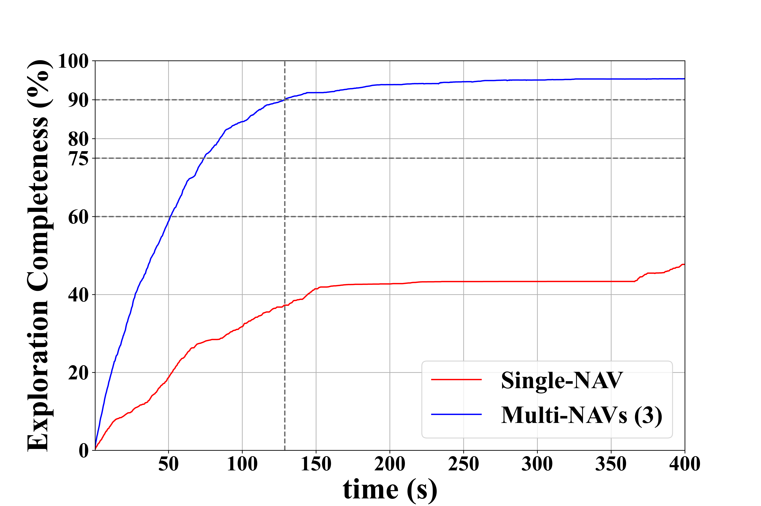
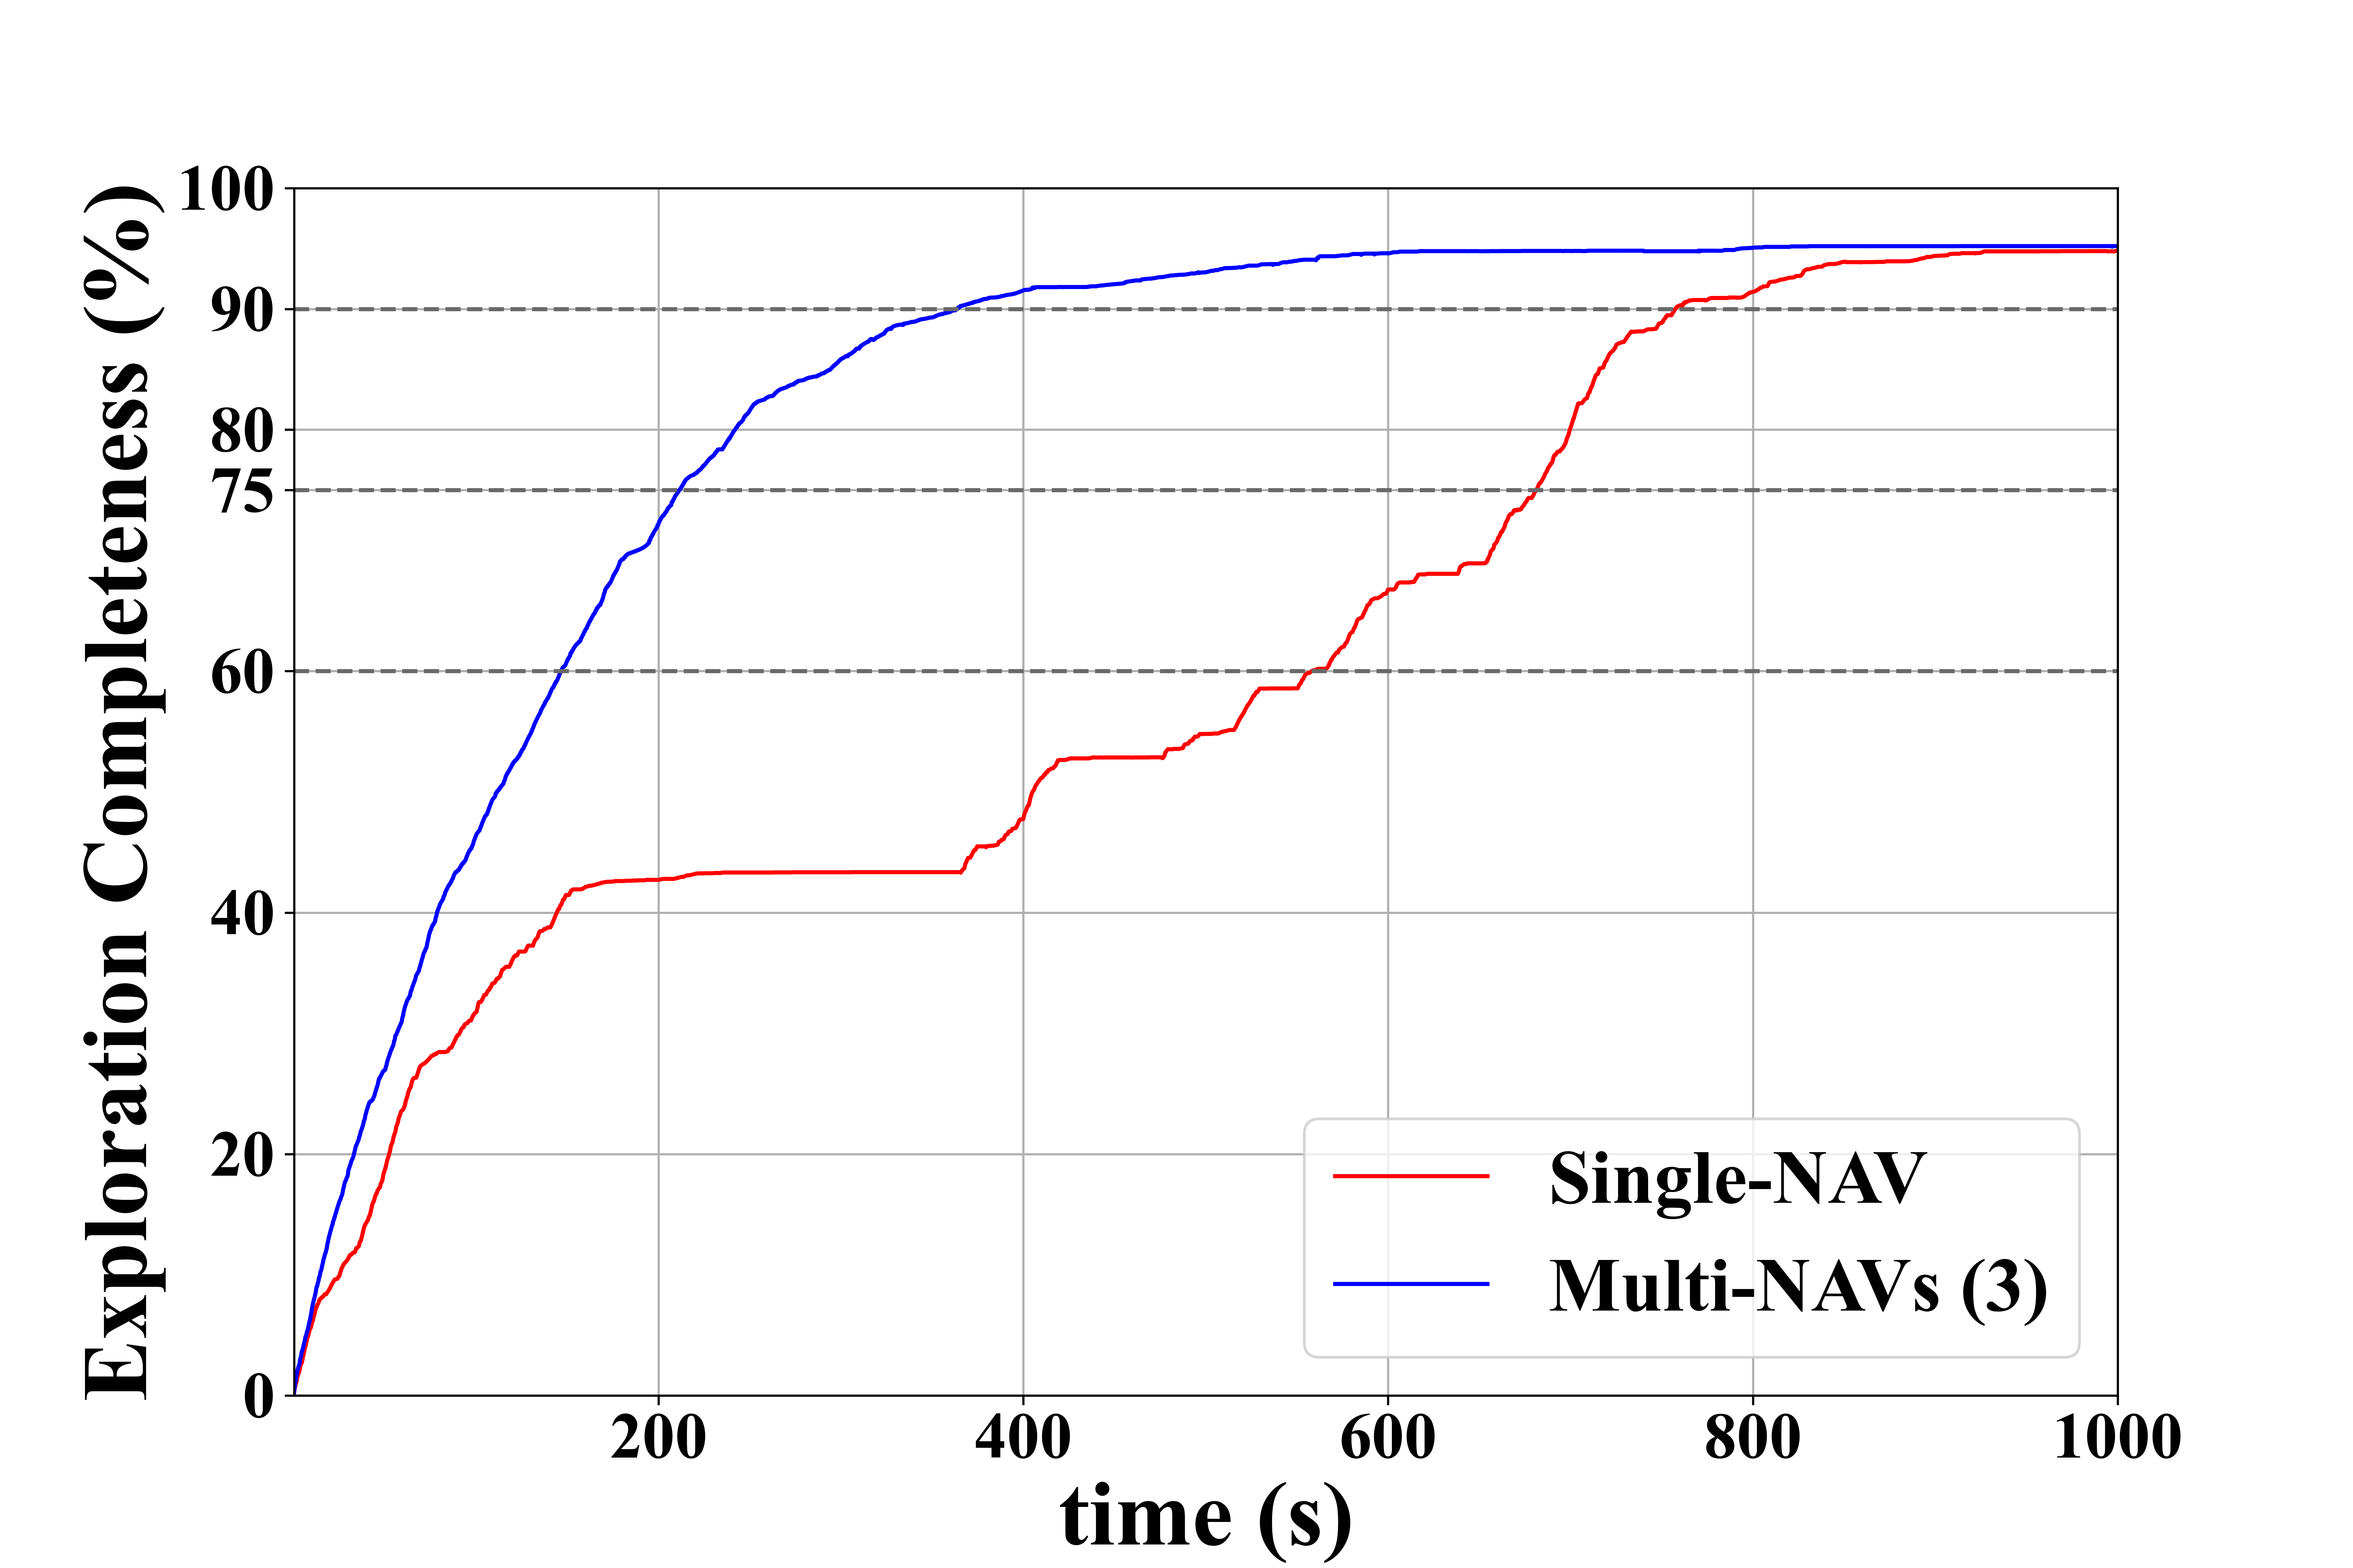
Comparison of Single-NAV and Triple-NAVs(4cm accuracy)
Results comparing single-NAV and triple-NAVs ：
90
757.75
37.26
364
Same time
Same times
 | Exploration completeness(%)
Single-NAV | 37.26
Triple-NAVs | 90
 | 90% exploration
 | Time(s)
Single-NAV | 757.75
Triple-NAVs | 364
Notes:
We compare the performance of single NAV and triple NAVs under the same time and the same times of explorations. The performance of triple NAV reaches more than 2 times the effect of single NAV when reaching 90% exploration, which indicates the high effectiveness and efficiency of multi-NAV in exploration and mapping.

Slide 29
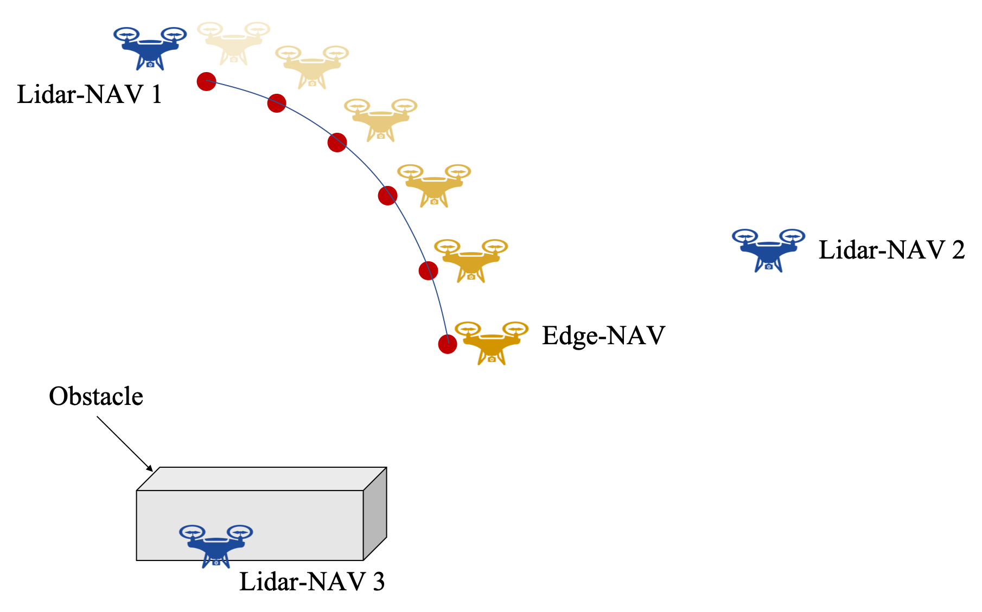
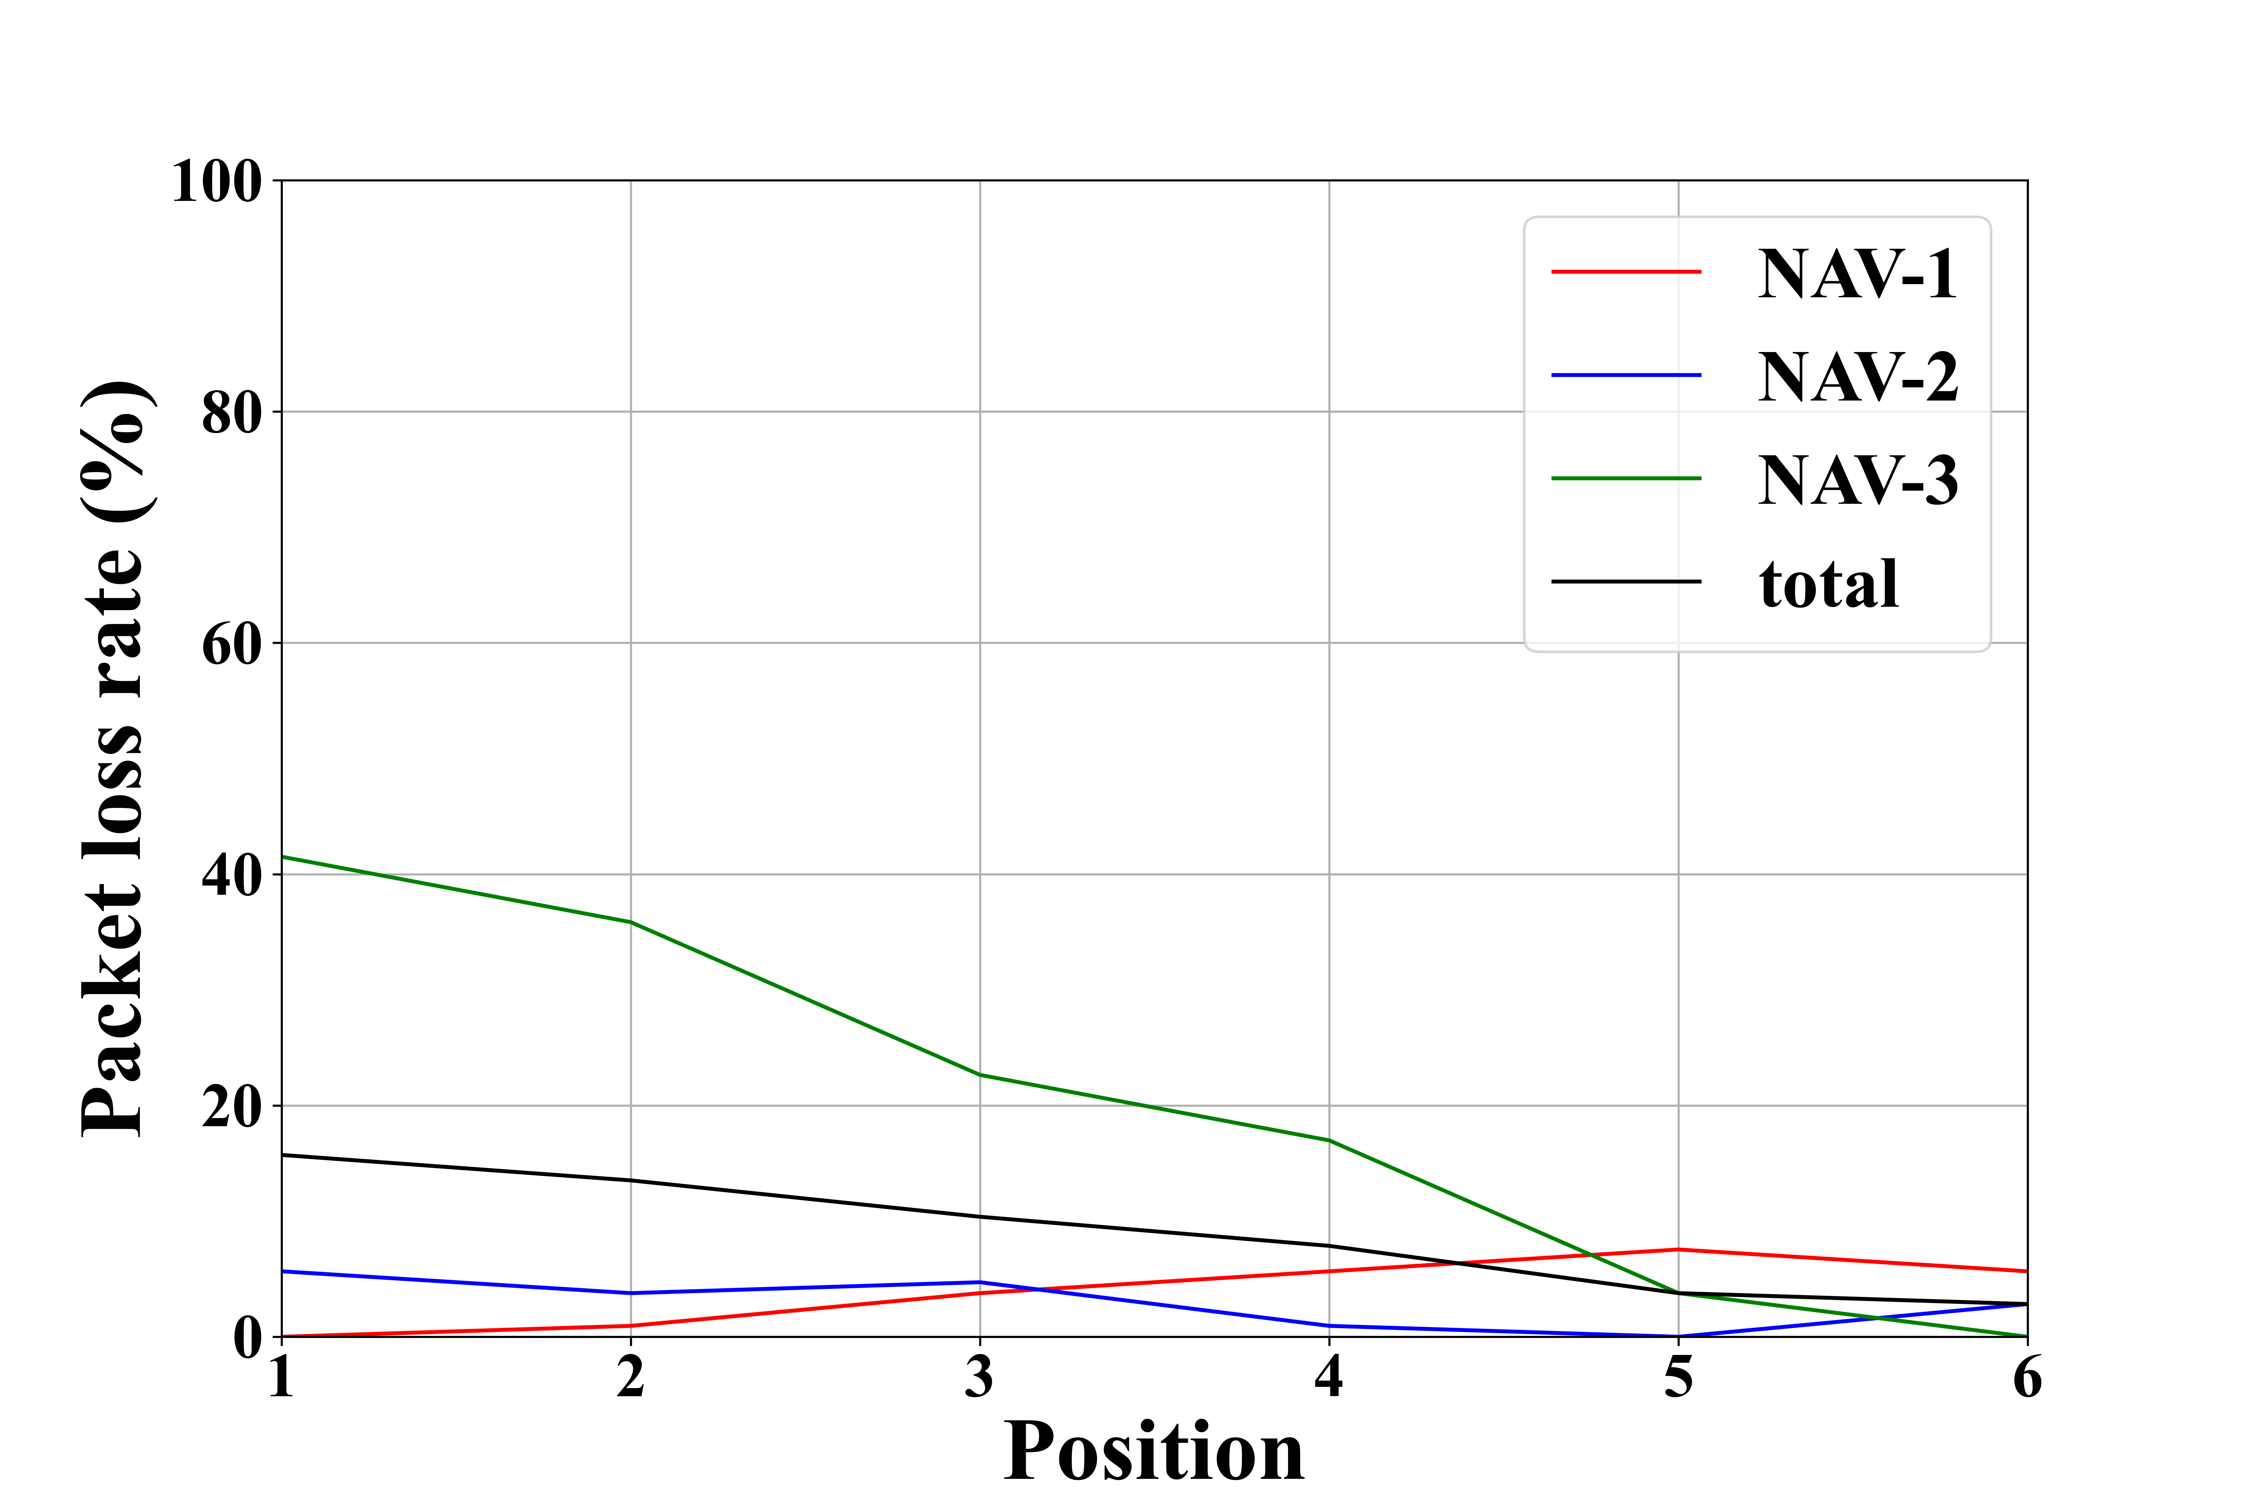
Triple-NAVs Real Result
Dynamically adjusting edge NAV using APF method results on packet loss rate:
(b) Packet loss rate varies with different positions
(a) Dynamic position
Notes:
In the real environment, we designed experiments to verify that it is effective for communication quality optimization that dynamic adjustment of Edge-NAV position based on APF method.

Slide 30
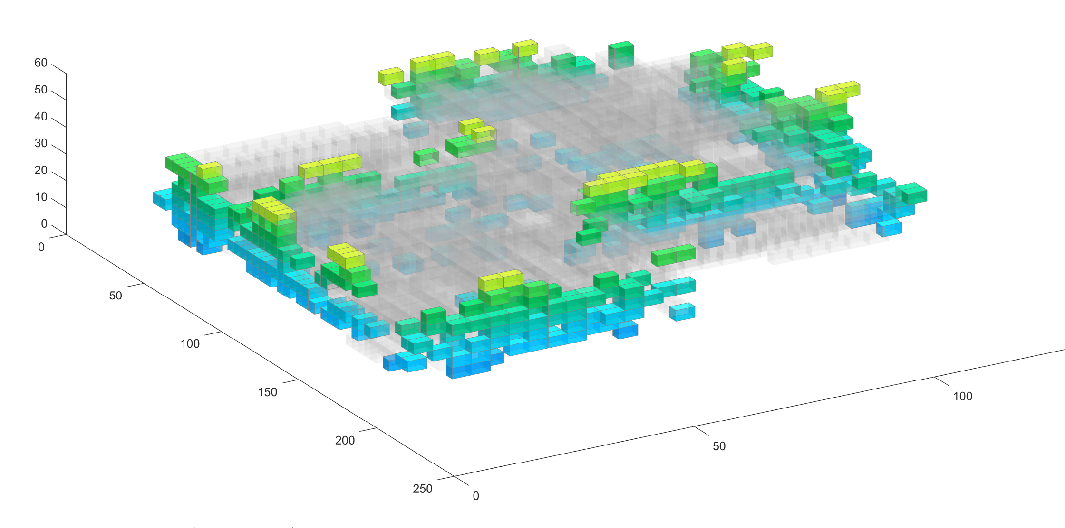
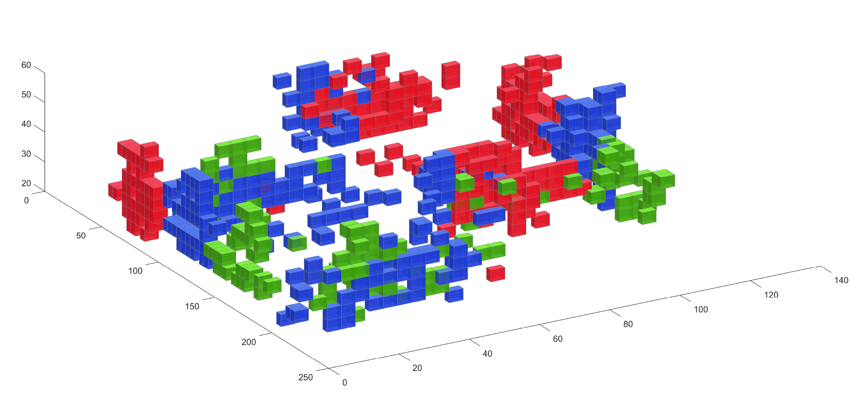
Three-NAVs Real Result
Real experimental results：
Time = 30s
Tricolor map
Gray squares represent known areas.
Notes:
Finally, this show the completion of the multi-NAVs building in real experiments. The gray area is known. Due to flight safety considerations, the NAVs flight experiment time is only 30s.

Slide 31
06
PART SIX
Conclusion

Slide 32
Conclusion
In this paper, we propose a cooperative NAV system using heterogeneous NAVs for autonomous mapping in unknown and confined environments. The main tasks are as follows:
We propose an improved map model: TinyOctomap.
We propose the active exploration strategy, which improves memory usage efficiency while ensuring exploration efficiency.
We design an efficient computing offloading strategy.
We have conducted a large number of simulations and real experiments to verify the robustness and effectiveness of the system.
Notes:
To sum up, we propose a cooperative NAV system using heterogeneous NAVs for autonomous mapping in unknown and confined environments. The main tasks are as follows:
We propose an improved map model: TinyOctomap.
We propose the active exploration strategy, which improves memory usage efficiency while ensuring exploration efficiency.
We design an efficient computing offloading strategy.
We have conducted a large number of simulations and real experiments to verify the robustness and effectiveness of the system.

Slide 33
Thanks for your listening!
Yongtao Ou(yongtao@seu.edu.cn)
Feng Shan(shanfeng@seu.edu.cn)
Southeast University, China
Notes:
Thank you for your listening. If you have any questions or need further information, please feel free to ask.

